Slide 1
E-Stores
e-Stores have many titles:
...Company Stores
...eCommerce Websites
...On-Line Programs
For the sake of simplicity we call them e-Stores

Slide 2
What is an e-Store?
An “e-Store” put simply, is a website that streamlines & simplifies selling products and/or services
...Other uses for e-Stores are Achievement Awards for Employees/Agents and Recognition for Years of Service and Loyalty
e-Store's have grown in popularity due to their efficiencies for ordering products and services and guaranteeing consistency for:
-Corporate branding & merchandising -Inventory management -Custom orders -Secure access for purchasing by individuals and departments

Slide 3
e-Store Features
Design Control: Freshening the website design is simple
E-commerce Ready: Several payment methods are available through either Credit Cards, Purchase Orders, Cost Centers, Gift Cards, Budgets etc (A single payment method may be chosen or a combination)
Shipping/Taxes: Calculated in real time
Discount Codes: Create one-time or reusable discount codes
Customer Groups: Organize Customer accounts into easy to manage groups and offer special discounts, restrict payment and/or shipping etc.
Simple Report Management
Robust Product Display: Multiple product options like size, color quantity pricing, images etc.

Slide 4
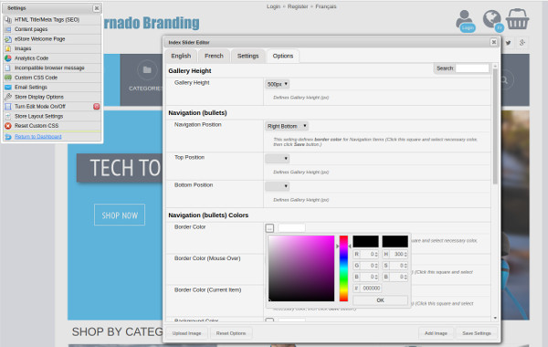
e-Store Design and Control
Templates are a starting point for making your new e-Store simple and beautiful
Match a Corporate website or create something new
Add Images, Banners, Sliders & more
Add your own CSS Code if needed
Admin Mode provides full access to settings, Fonts & Colors.

Slide 5
e-Commerce Ready
The e-Store can accept several methods of payment
PURCHASE ON ACCOUNT/PURCHASE ORDER - A Purchase order number or equivalent is needed to use this payment method.
BILL ME - Purchases can be paid using payment terms
COST CENTRE - Purchases are allocated to a Corporate Cost Centre
Credit Card Payments: PAYPAL EXPRESS CHECKOUT, PAYPAL PRO DIRECT PAYMENTS, MONERIS CANADA, Authorize.net US
BUDGETS - A powerful feature that provides the ability to control spending by User. Approvers can also be defined which provides further control
STORE CARDS (Gift cards) - This payment method allows for an unlimited amount of Store cards of any denomination.

Slide 6
Shipping & Taxes
SHIPPING: Your eStore can offer one or several shipping methods at check out. Buyers can choose their best option.
CANADA POST & PUROLATOR - Calculate real-time shipping rates for the destination, based on the total weight of the items in the cart.
UPS - With your API Access and account number, your regular earned rates will apply.
FEDEX - Calculates real-time shipping rates for the destination, based on the total weight of the items in the cart
CUSTOM DESTINATIONS AND FORMULAS - Allows creation of custom shipping calculations based on country/territory combinations.
TAXES: Current Tax rates are automatically populated for Canada and USA. You can add specific rules for US taxes to suit any jurisdiction.

Slide 7
Discount Codes
Discount Codes are usually for special offers that are activated with reference to a key word or phrase added to the check out process. Example: “When checking out use “Extra 10” to receive an additional 10% discount”
Create one-time or reusable discount codes.
They can be defined as price reduction for product, shipping, taxes etc or a combination of all 3

Slide 8
Customer Groups
Customer Groups are used to define groupings of customer accounts. Customer groups can have specific attributes such as:
Group Discount formulas
Specific Payment Methods
Specific Shipping Methods
Make products visible only to certain groups

Slide 9
Simple Report Management
STANDARD REPORTS:
-Budget List -Budget Usage -Current Inventory Count -Customer Account List -Customer Account List -Discount Code Usage -Order Related Reports for: Export General Sales Ledger Sales By Category Summary By Customer Summary By Shipping Destination Top Selling Items Transactions -Product Export -Product Inventory Export -Store Card Export -Store Card Usage
ALLOWING CUSTOMER ACCESS TO REPORTS
Customers can have limited access to pertinent reports. Customer access to valuable Reports removes the need for customer service calls relating to pertinent data

Slide 10
Robust Product Support
ADD/EDIT/IMPORT PRODUCTS & CATEGORIES The products section of the Dashboard provides access to all information regarding Products, Product Categories, Options, Pricing, Product Images and Product Imports ADD A PRODUCT: Adding products from the Dash Board is simple and can be managed individually, by a spread sheet or directly integrated with your own product database via the REST API and supports multiple languages PRODUCT OPTIONS: Options allow you to add specific additional choices to a product like size or color. Options can be setup as a list that a buyer would select from (ie: sizes) or a single option such as a gift box INVENTORY: The system will track inventory if needed.

Slide 11
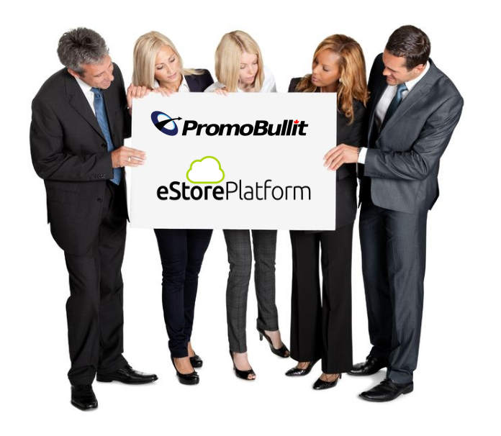
PromoBullit e-Store Platform Summary
Full-featured platform for all e-Store requirements
Customizable Designs
Extensive product option support (Color, Size, etc.)
Flexible payment support (Credit Cards, Budgets, PO, etc.)
Real-time or Custom shipping calculations
Bilingual, Multi-currency, Canadian & USA Taxes

